Slide 1

Let’s learn about the
WATER CYCLE!

Slide 2
GOALS:
Identify the phases of water found in the water cycle.
Name and describe the steps of the water cycle.
Recognize the forces that drive the water cycle.

Slide 3

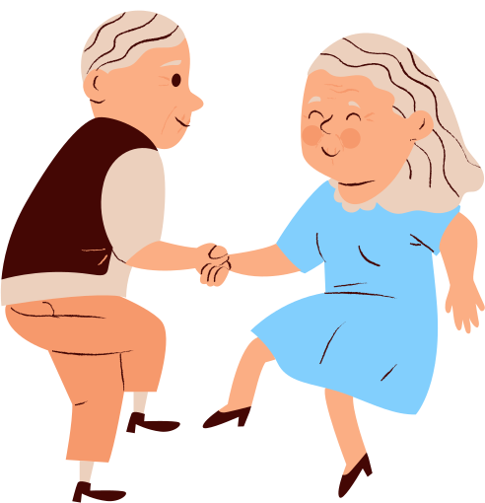
THE WATER CYCLE
Water is not created or destroyed - it is recycled! The water we drink today is the same water our great, great grandparents drank.
It is the same water that the dinosaurs drank!

Slide 4




PHASES OF WATER
Water on Earth can be either solid (snow and ice), liquid (water), or gas (water vapor).
solid water
liquid water
water vapor

Slide 5


solid water
water vapor
PHASES OF WATER
Liquid water is found in rivers, lakes, oceans and groundwater.
Snow is solid water.
Water vapor fills our atmosphere.
liquid water

Slide 6




THE WATER CYCLE
Water changes phases as it goes through the water cycle - sometimes it is liquid, sometimes solid, and sometimes a gas.

Slide 7


LIQUID TO GAS
EVAPORATION
Let’s start with liquid water - water in your glass, and water in a lake or ocean!
When water gets warm, water molecules begin moving faster. Some move so fast that they break away and float up into the air. This is called evaporation.

Slide 8
LIQUID TO GAS
EVAPORATION
What powers the evaporation of water?

Slide 9
THE SUN
EVAPORATION
The sun’s thermal energy powers the phase change of water from liquid to gas.
This power can move water from the lowest points on Earth (sea level) to the highest - the tops of mountains!

Slide 10
TRY IT!
Get two glasses of water.
Put one outside in the sun, and the other inside your house or classroom. Check on the glass every day.
Which glass of water evaporates faster?
Why do you think that happened?
EVAPORATION

Slide 11
GAS TO LIQUID
As warm air rises, it cools. Cooler air can’t hold as much water vapor, so the water vapor condenses into tiny droplets of liquid water or ice crystals.
Water droplets cluster together, forming clouds. This is the process of condensation.
CONDENSATION

Slide 12


TRY IT!
CONDENSATION
Fill a cup with very warm water. Place an empty cup on top of the first, upside down.
Put an ice cube on top of the empty upside down cup.
Water will evaporate from the warm cup, and then condense in the top cup near the cold ice cube!
What happens to the condensed water?
EVAPORATION

Slide 13


FALLING LIQUID (OR SOLID!)
When enough water condenses in a cloud, the drops get so heavy, they fall from the cloud. This is called precipitation.
Water can fall as rain or as snow, sleet or hail (solid water!) if it is cold enough.
PRECIPITATION

Slide 14
FALLING LIQUID (OR SOLID!)
What force causes precipitation to fall to Earth?
PRECIPITATION

Slide 15


GRAVITY!
Gravity pulls rain and snow from the clouds to the ground.
Gravity also causes water to run downhill. This is called runoff.
PRECIPITATION
RUN OFF

Slide 16
GRAVITY!
Runoff collects into rivers that flow downhill (gravity!) until they eventually reach the ocean.
Some water is pulled into the soil and makes up ground water.
PRECIPITATION
RUN OFF

Slide 17
TRY IT!
CONDENSATION
What happens with the water in the condensation experiment?
Eventually, the drops get so big and heavy, gravity pulls them down into the glass of water.
This is exactly what happens inside clouds to form precipitation.
PRECIPITATION

Slide 18

THE WATER CYCLE
CONDENSATION
Now we have a name for each part of the water cycle!
EVAPORATION
PRECIPITATION

Slide 19


MORE TO THE WATER CYCLE
When a plant takes water up from its roots, it eventually travels all the way to the leaves. Water evaporates from the leaf, which is called transpiration.
TRANSPIRATION

Slide 20
MORE TO THE WATER CYCLE
When it rains, some water forms into a puddle or collects in waterbodies. Some of the water can also be absorbed into the soil and be stored underground. This is called infiltration.
PRECIPITATION
INFILTRATION

Slide 21
MORE TO THE WATER CYCLE
One more!
Sometimes snow or ice changes into water vapor without first melting into water, this is called sublimation.
SUBLIMATION

Slide 22
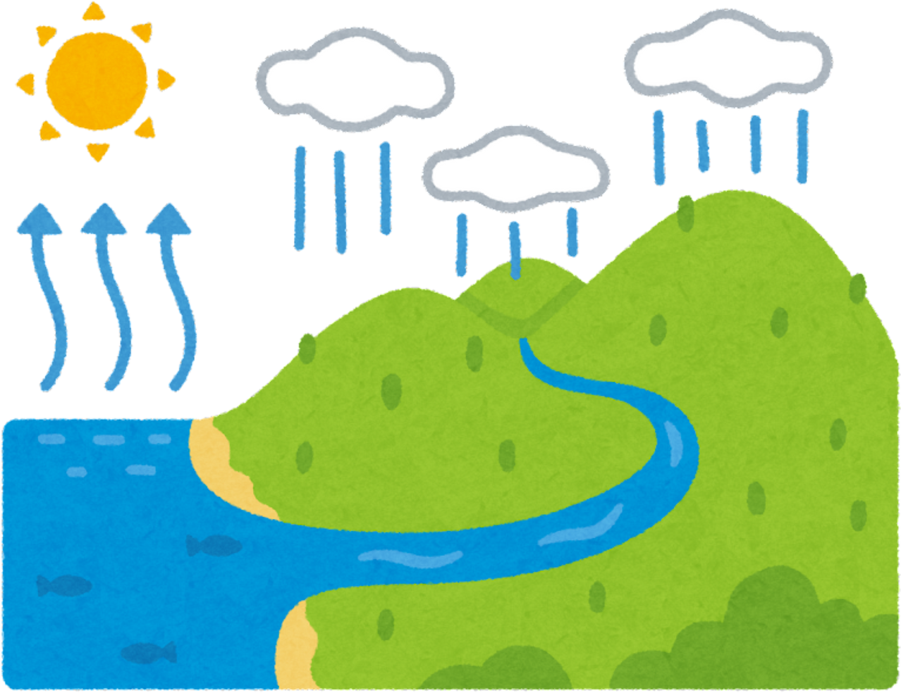


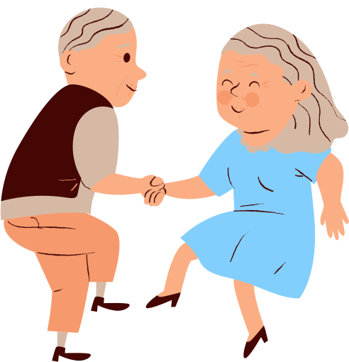
condensation
THE WATER CYCLE
precipitation
transpiration
Water continues to move through the water cycle - forever!
runoff
evaporation

Slide 23
CAN YOU...
Identify the phases of water found in the water cycle.
Name and describe the steps of the water cycle.
Recognize the forces that drive the water cycle.

Slide 24
Do you have any
QUESTIONS?

